Slide 1
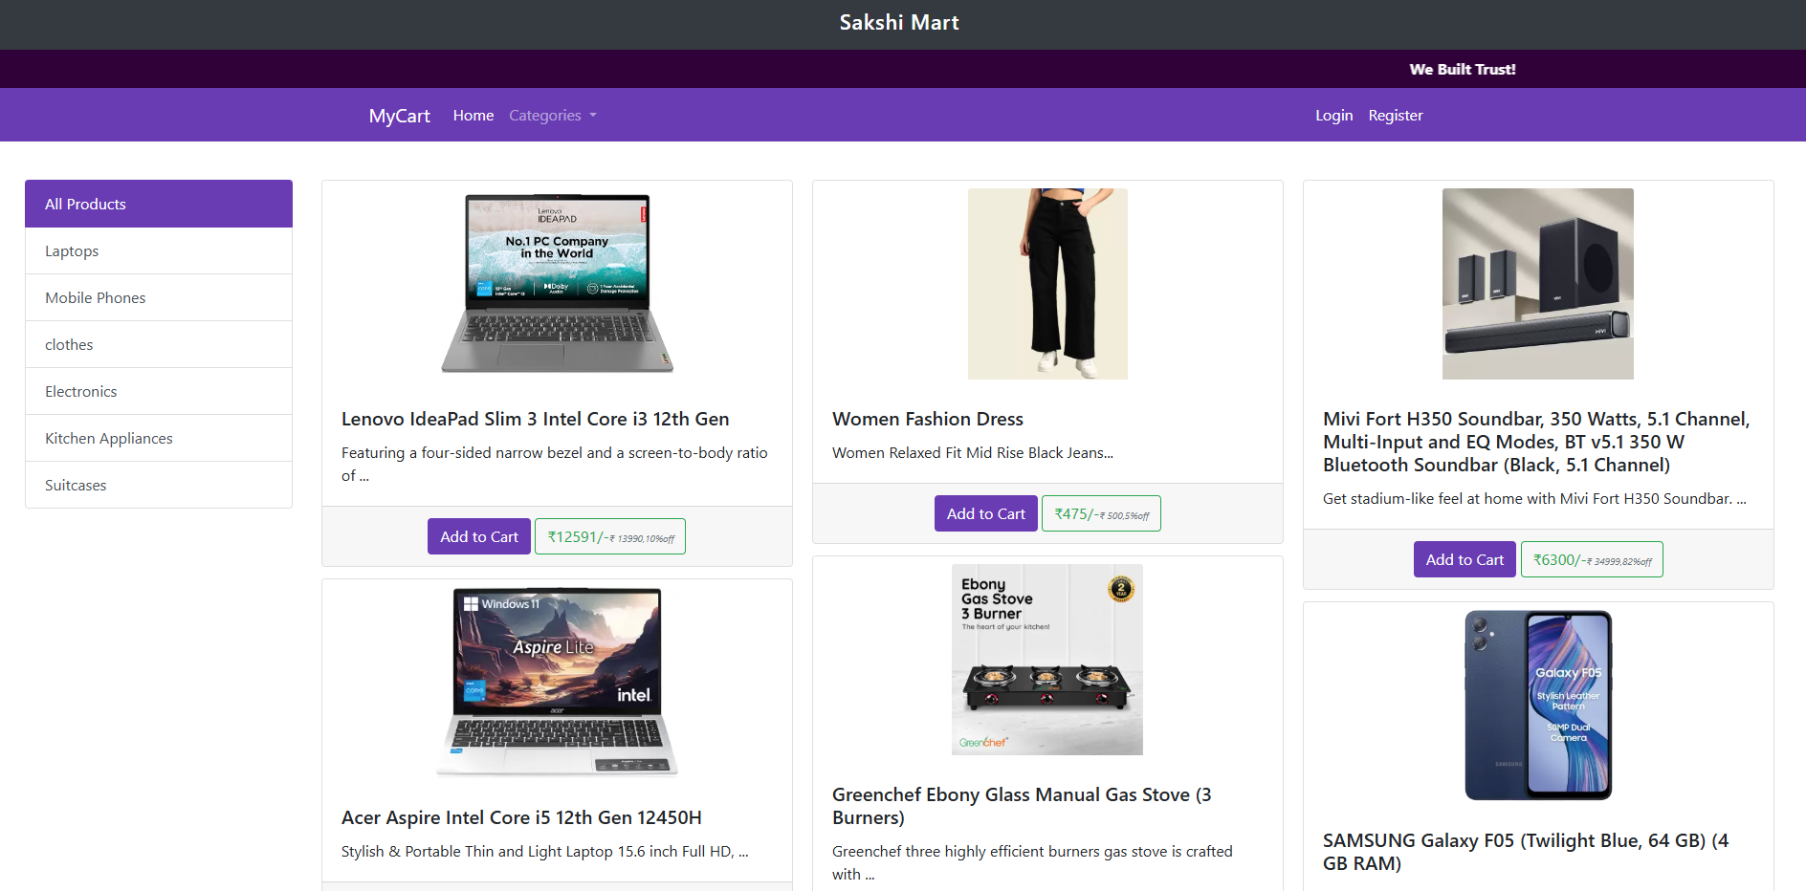
Sakshi Mart

Slide 2
Workflow
Customer Workflow
Customer Login
Shopping Window
Cart Summary
Place Order
Retailer Workflow
Admin Login
Add/Remove Product
Admin Dashboard

Slide 3
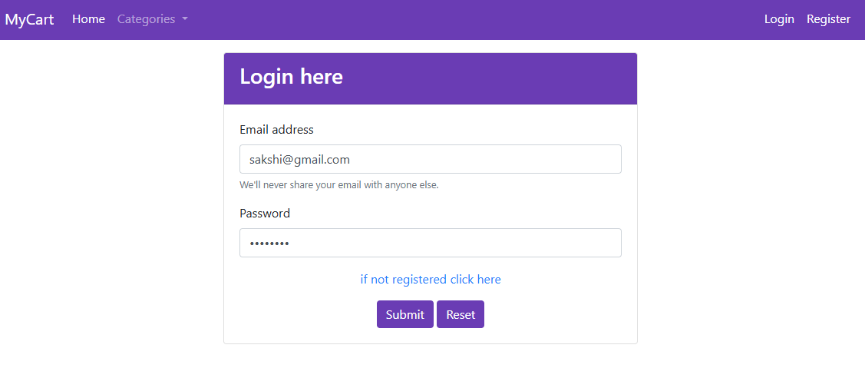
Customer Workflow
Customer Login
Shopping Window
Cart Summary
Place Order

Slide 4
Customer Login

Slide 5
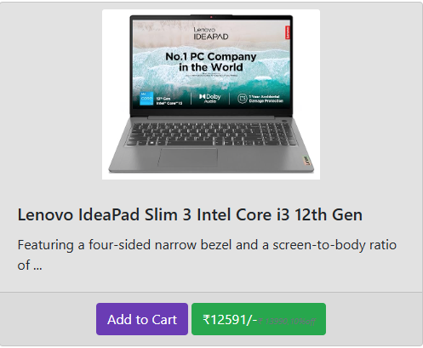
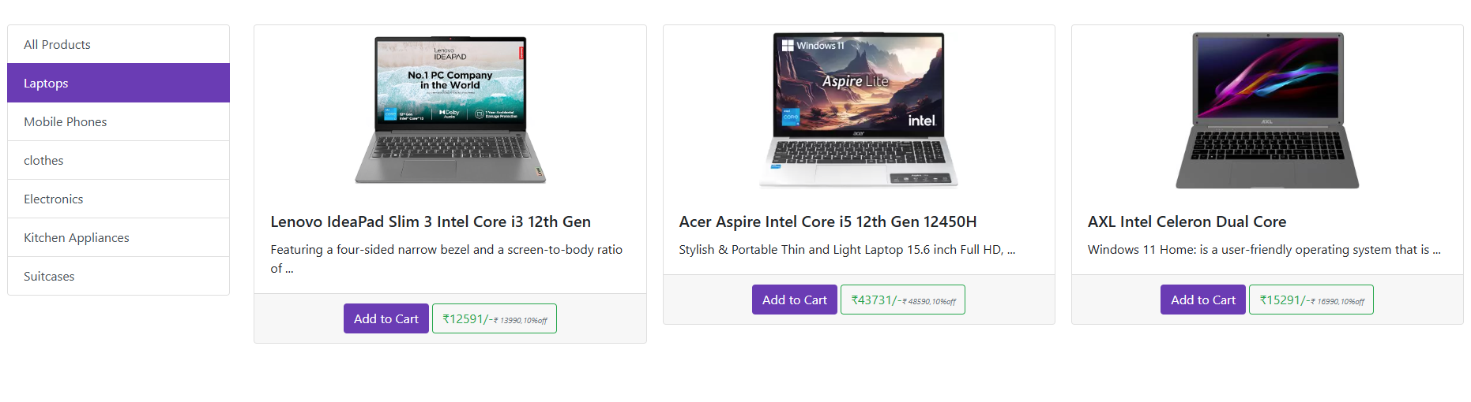
Shopping Window
Discount Highlight
Category Based Distribution

Slide 6
Cart Summary

Slide 7
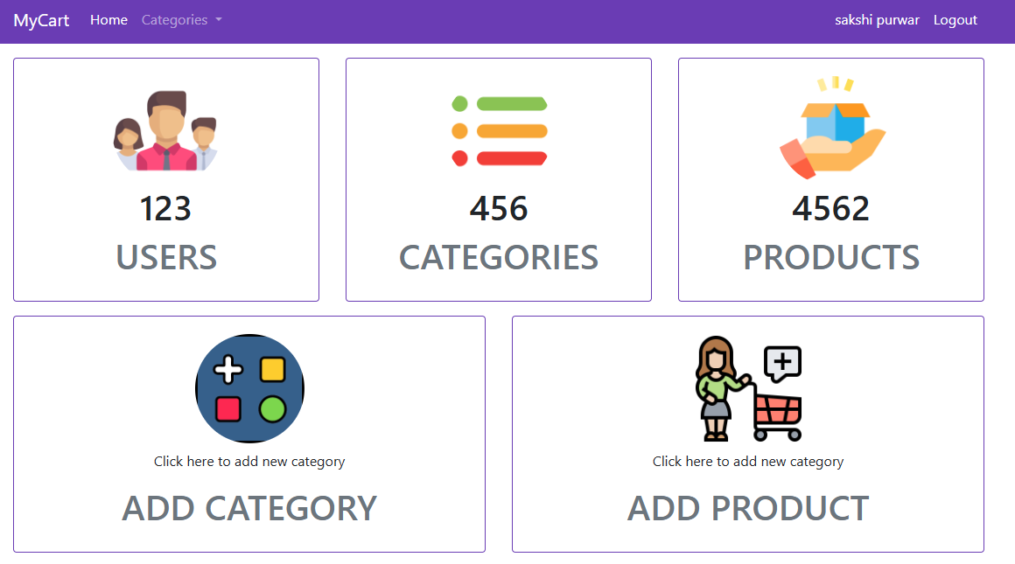
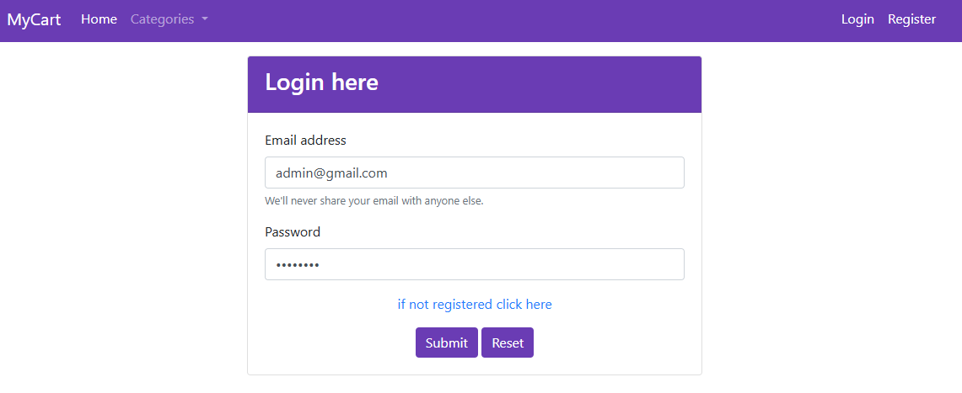
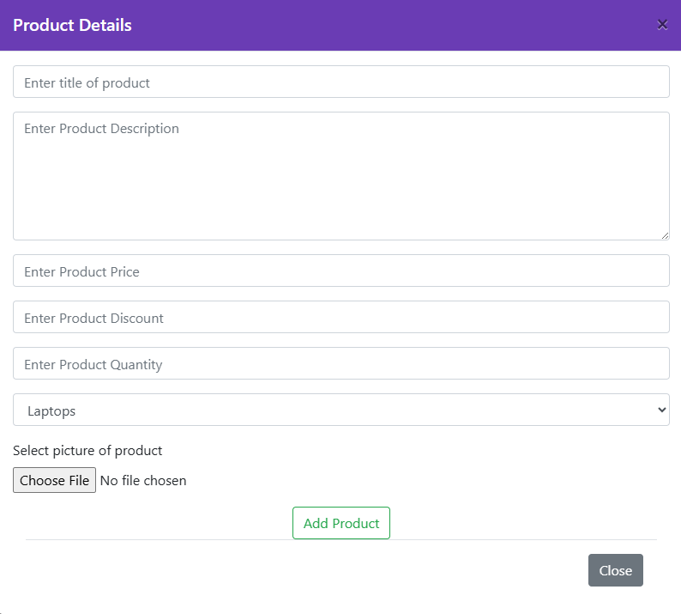
Retailer Workflow
Admin Login
Add/Remove Product
Admin Dashboard

Slide 8
Admin Login

Slide 9
Add/Remove Product

Slide 10
Admin Dashboard

Slide 11
Technologies Used
🧱 HTML – Structure of the Interface
Builds the basic layout and structure of the web pages
Forms the foundation for user interaction elements
🎨 CSS – Styling and Design
Adds visual appeal and layout responsiveness
Enhances user experience through custom styling
💠 Bootstrap – Responsive UI Framework
Provides pre-built classes for layout, components, and styling.
Used for responsive navigation bar, product cards, and form design.
☕ Java – Backend Logic
Handles core business logic and server-side processes
Manages user requests, sessions, and data flow
Servlets handle business logic and connect with the database layer.
🗃️ JDBC – Database Connectivity
Connects Java code to relational databases
Executes SQL queries for CRUD operations
🔄 Hibernate – ORM Framework
Maps Java objects to database tables (Object-Relational Mapping)
Reduces code and simplifies DB interactions
♻️ Singleton Pattern – Design Principle
Restricts a class to one instance (For DB connection factory)
Promotes efficient resource use and consistent behavior

